Slide 1


Device Virtualization
DMA, the IOMMU, and address translation
Luc MAHOP · PhD candidate, Université Grenoble Alpes · 16th October 2026
Notes:
Introduce yourself in one sentence, including your thesis topic. The course ends exactly where your research begins, so say that up front — it gives the two hours a destination.

Slide 2
Course Contains
1- DMA
2- The IOMMU
3- VIRTUALIZING DEVICES
4- NESTED TRANSLATION
Assumed background: MMU, page tables, TLB, CPU virtualization (VM exits, EPT/NPT)
Notes:
State the assumed background out loud. Everything else is built from scratch, so nobody should feel lost; conversely, we will not re-explain page tables.

Slide 3
A device reaches memory without CPU consent.
How do we isolate, virtualize and share those accesses
Notes:
This is the guiding question of the whole course. Come back to this slide at the end and answer it together with the room, in one sentence.

Slide 4
The per-packet budget
I · DMA
10 Gb/s
833 000
1.2 µs
120 ns
line rate
1500-byte frames per second
of CPU budget per frame
the same, at 100 Gb/s
Moving the bytes with the CPU would consume that budget on its own.
CPU end up busy moving frames most of its time.
10Gb / (1500 × 8) ≈ 833 333 frames/s, Ethernet overhead ignored
Notes:
Do the arithmetic on the board with them rather than showing it. The 120 ns figure comes back in exercise 2, so leave it on screen for a moment.

Slide 5
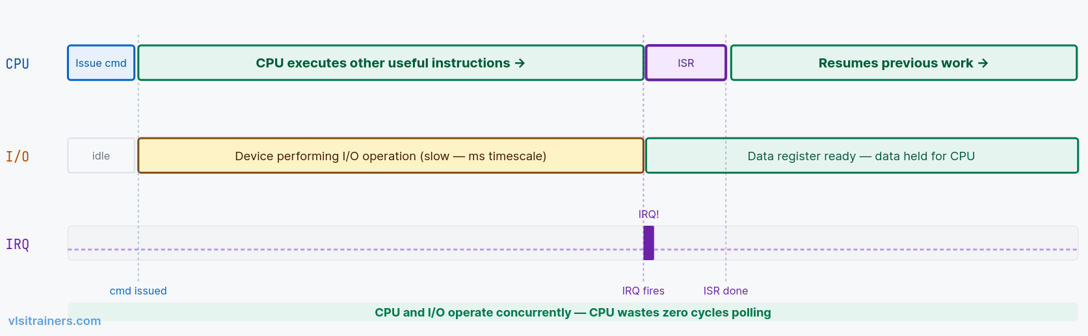
Interrupt-Driven I/O
I · DMA
This packet is the running example for the next two hours
Notes:
Mention cache coherence (coherent on x86, not always on ARM) and NAPI for interrupt coalescing. Keep the five boxes visible: every later part of the course modifies one of them.

Slide 6
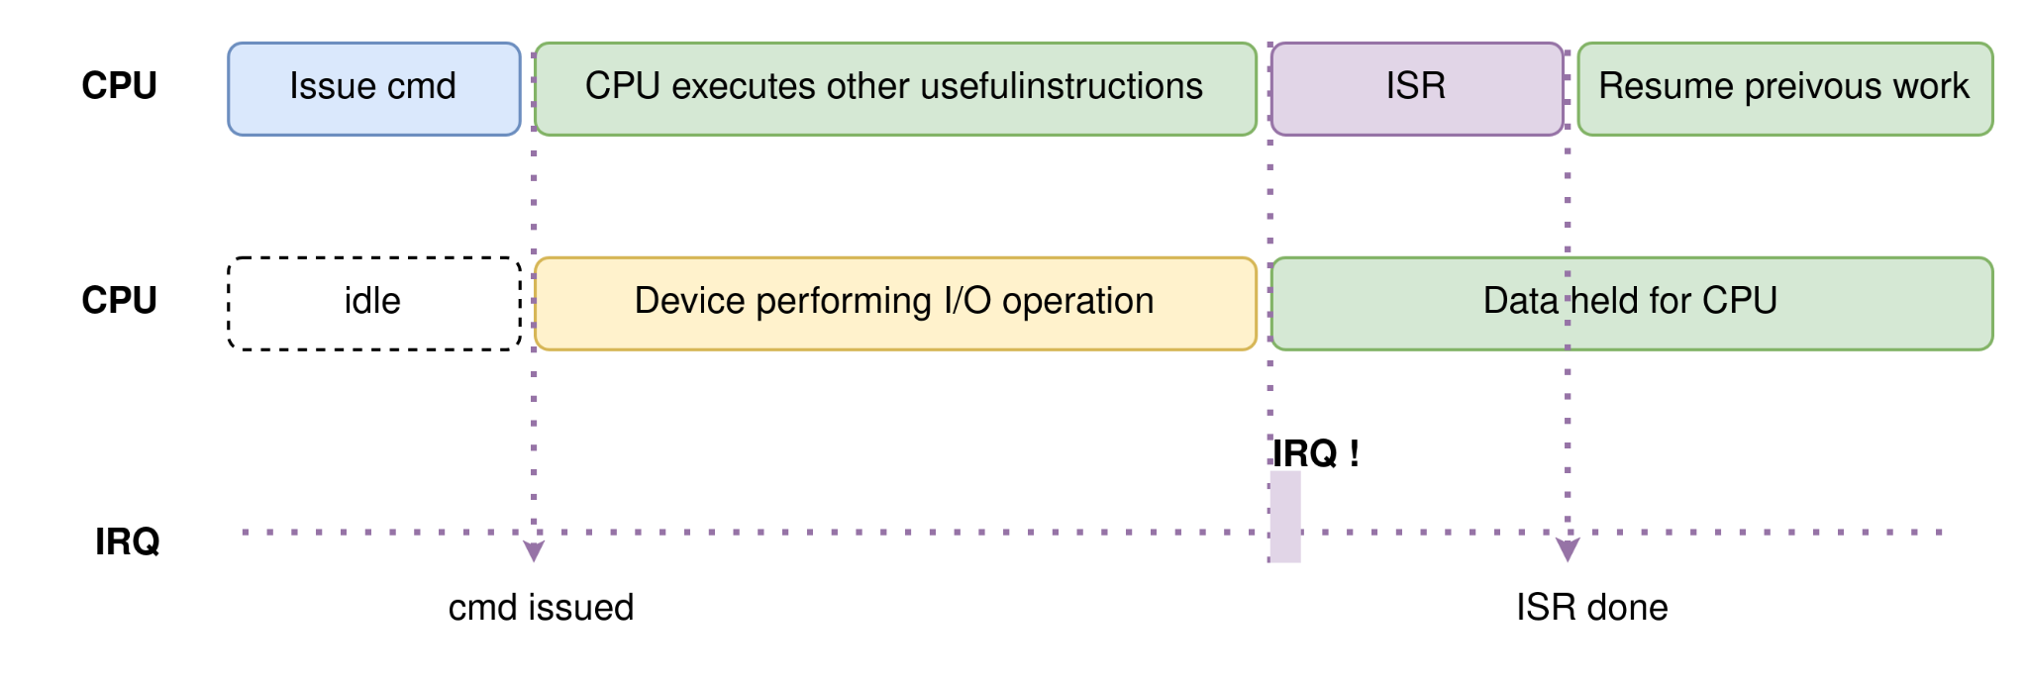
Interrupt-Driven I/O (Historical)
I · DMA
Notes:
Mention cache coherence (coherent on x86, not always on ARM) and NAPI for interrupt coalescing. Keep the five boxes visible: every later part of the course modifies one of them.

Slide 7
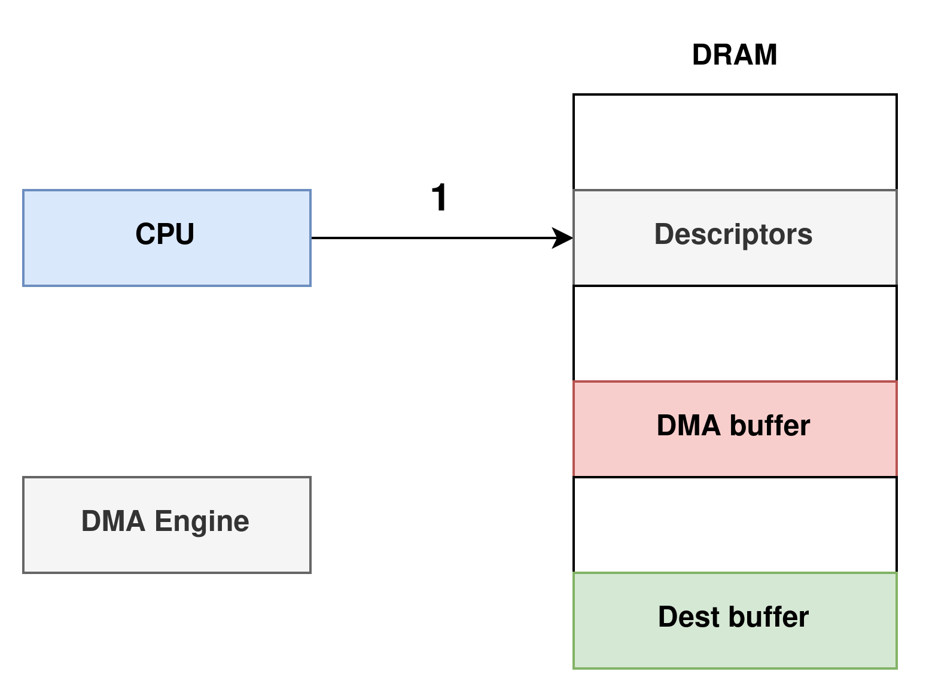
Direct Memory Access
I · DMA
1. driver creates a descriptor for a DMA buffer.
Notes:
Mention cache coherence (coherent on x86, not always on ARM) and NAPI for interrupt coalescing. Keep the five boxes visible: every later part of the course modifies one of them.

Slide 8
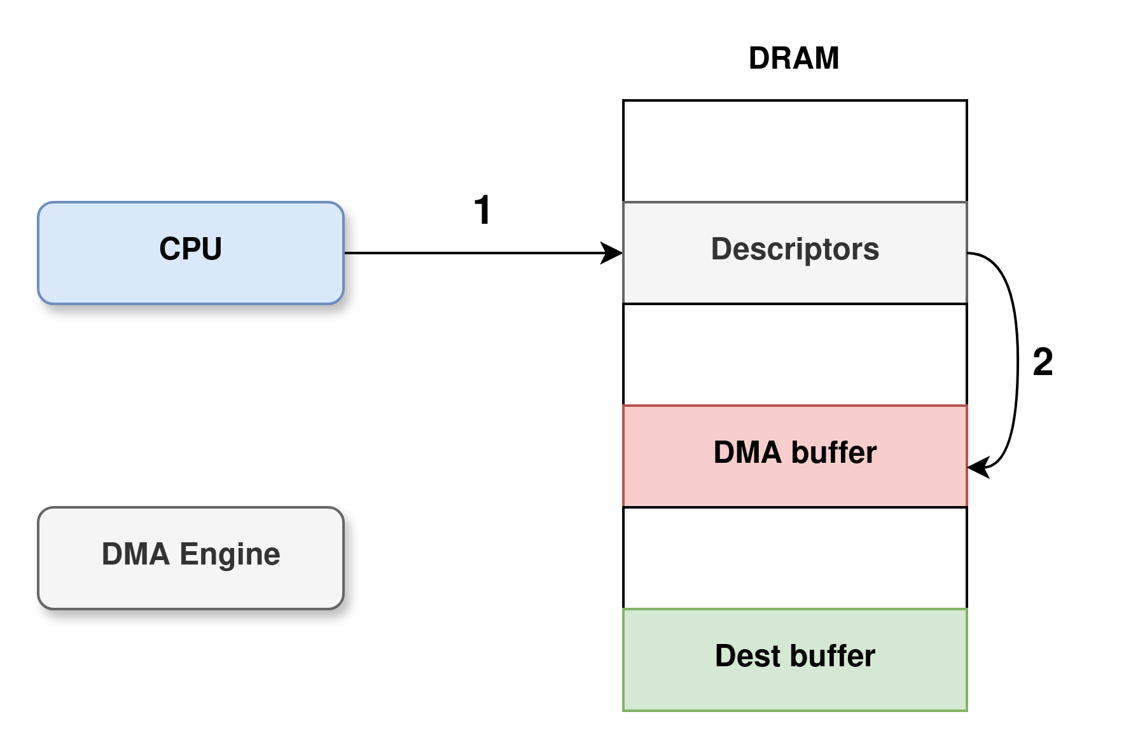
Direct Memory Access
I · DMA
2. driver allocates a DMA buffer and initializes the descriptor
Notes:
Mention cache coherence (coherent on x86, not always on ARM) and NAPI for interrupt coalescing. Keep the five boxes visible: every later part of the course modifies one of them.

Slide 9
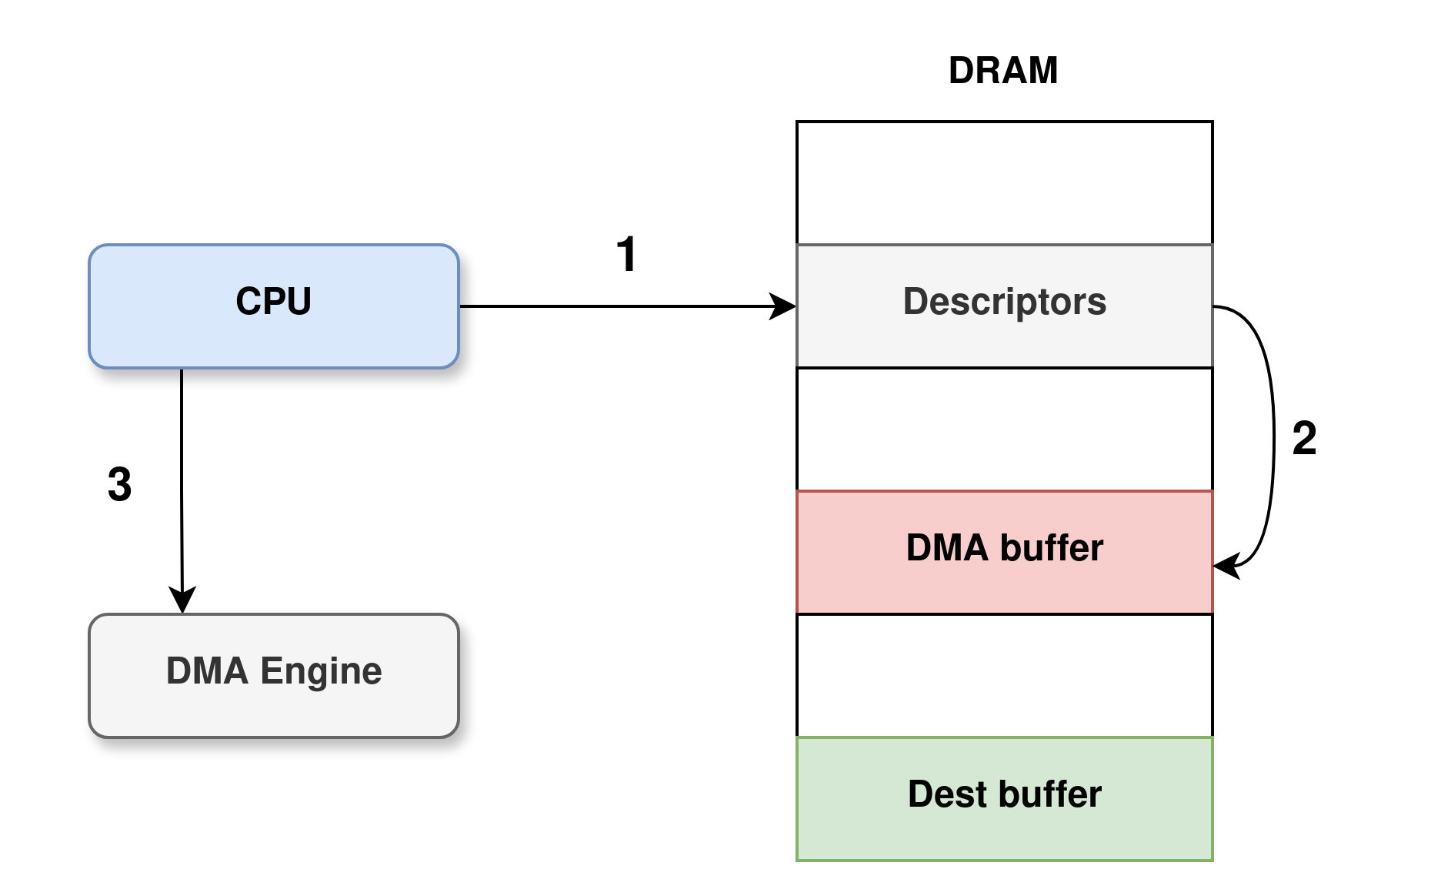
Direct Memory Access
I · DMA
3. The driver informs the DMA engine of the descriptor start address.
Notes:
Mention cache coherence (coherent on x86, not always on ARM) and NAPI for interrupt coalescing. Keep the five boxes visible: every later part of the course modifies one of them.

Slide 10

Direct Memory Access
I · DMA
4. The DMA engine loads the descriptor's content from the memory.
Notes:
Mention cache coherence (coherent on x86, not always on ARM) and NAPI for interrupt coalescing. Keep the five boxes visible: every later part of the course modifies one of them.

Slide 11
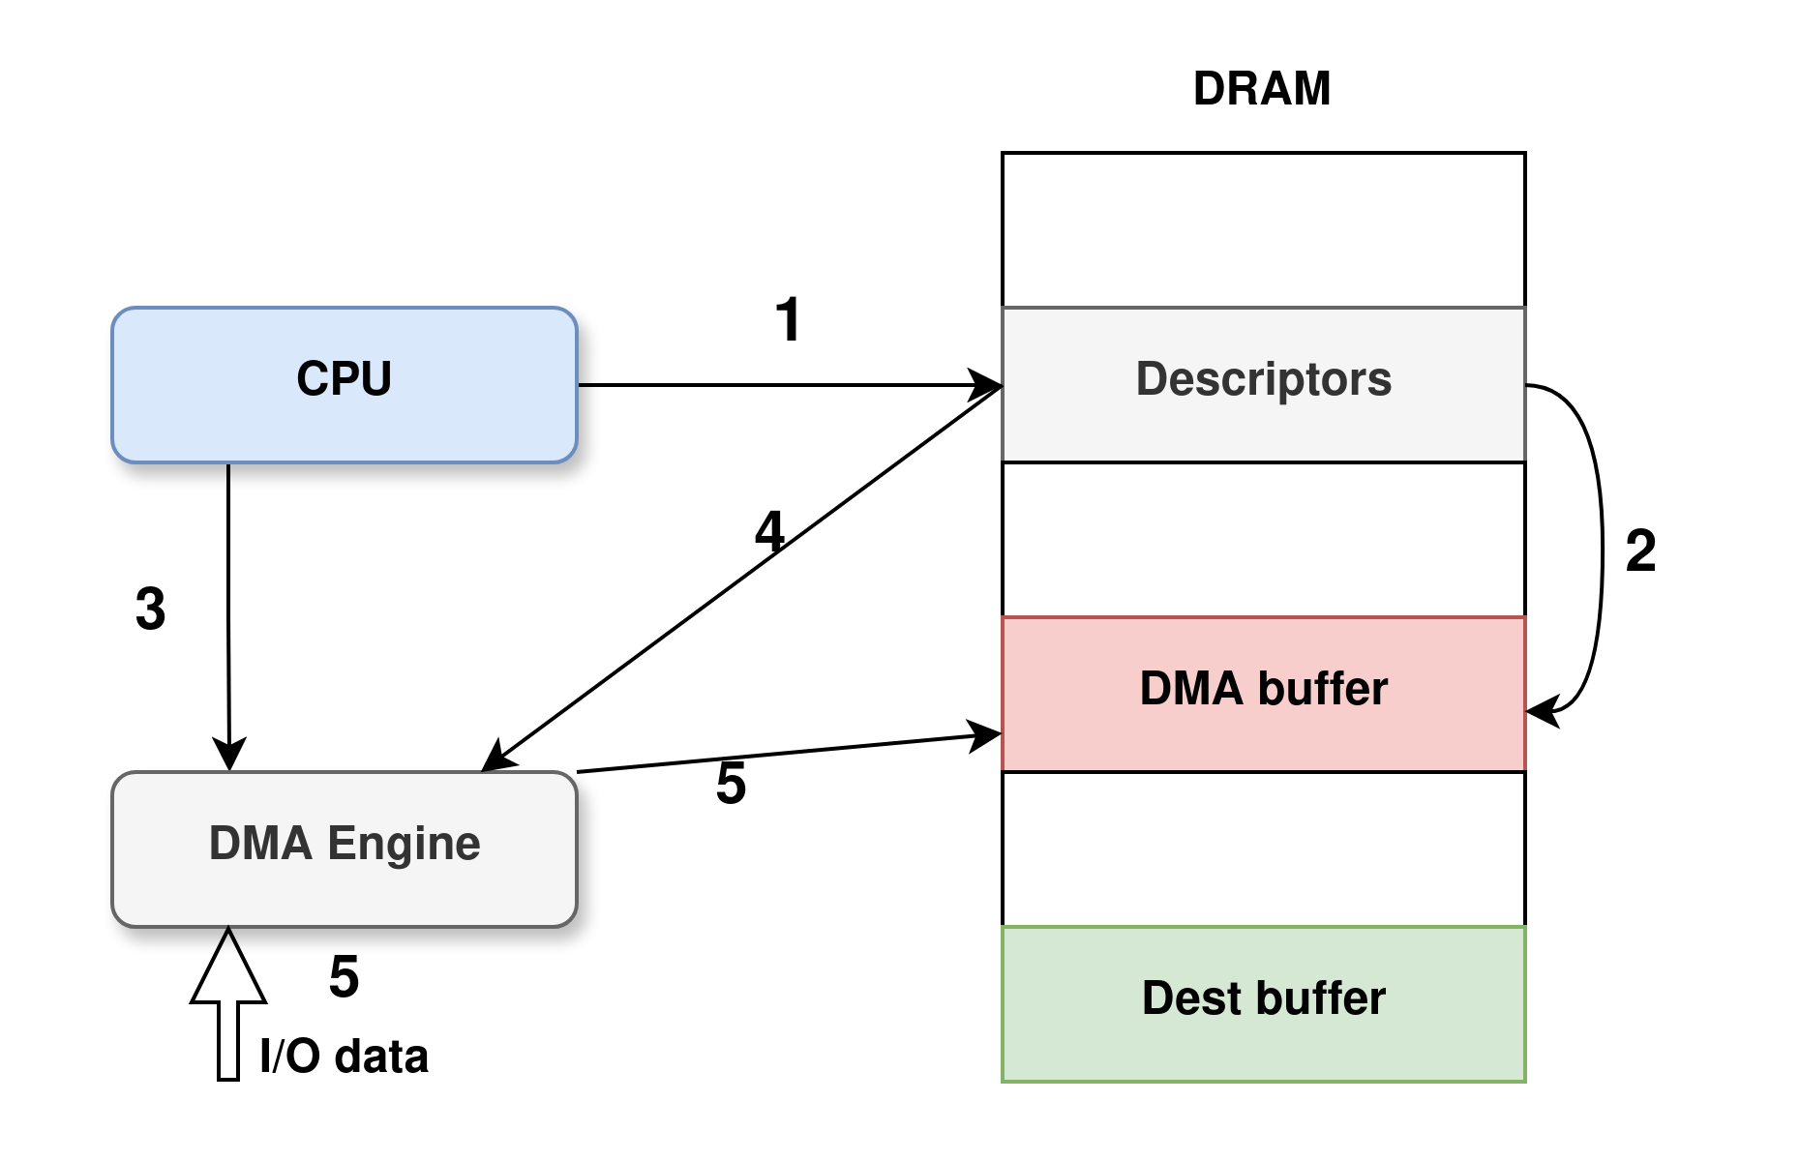
Direct Memory Access
I · DMA
5. the DMA engine receives the data from the I/O device and update the DMA buffer.
Notes:
Mention cache coherence (coherent on x86, not always on ARM) and NAPI for interrupt coalescing. Keep the five boxes visible: every later part of the course modifies one of them.

Slide 12

Direct Memory Access
I · DMA
6. At the end the DMA buffer, the owner status of the descriptor is modified to be the DMA engine.
Notes:
Mention cache coherence (coherent on x86, not always on ARM) and NAPI for interrupt coalescing. Keep the five boxes visible: every later part of the course modifies one of them.

Slide 13

Direct Memory Access
I · DMA
7. The DMA engine sends an interrupt to the processor to indicate the completion.
Notes:
Mention cache coherence (coherent on x86, not always on ARM) and NAPI for interrupt coalescing. Keep the five boxes visible: every later part of the course modifies one of them.

Slide 14

Direct Memory Access
I · DMA
8. driver handles the interrupt and copies DMA buffer to the Dest. buffer. Then frees DMA buffer
See Tang & al, DMA cache (HPCA 2010)
Notes:
Mention cache coherence (coherent on x86, not always on ARM) and NAPI for interrupt coalescing. Keep the five boxes visible: every later part of the course modifies one of them.

Slide 15
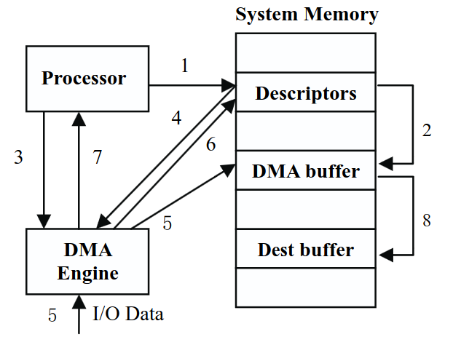

How Do DMA Operates (3/3)
I · DMA
7. The DMA engine sends an interrupt to the processor to indicate the completion.
8. driver handles the interrupt and copies DMA buffer to the Dest. buffer. Then frees DMA buffer
Tang & al, DMA cache (HPCA 2010)
Notes:
Mention cache coherence (coherent on x86, not always on ARM) and NAPI for interrupt coalescing. Keep the five boxes visible: every later part of the course modifies one of them.

Slide 16
Three problems with raw DMA
I · DMA
Security
Addressing
Contiguity
A buggy or hostile device reads and writes anywhere (See Thunderbolt DMA attacks).
A 32-bit device only sees the first 4 GB, so the kernel copies through bounce buffers.
Large buffers must be physically contiguous, or described as scatter-gather lists.
One cure for all three: put a translation between the device and memory.
Notes:
Ask them for the cure before revealing the last line. They know the MMU, so they will find it. That makes the IOMMU feel inevitable rather than arbitrary.

Slide 17


An MMU for devices
II · IOMMU
CPU
virtual address
MMU
VA → PA, page tables per process, TLB
RAM
PCIe device
IOVA
IOMMU
IOVA → PA, page tables per domain, IOTLB
RAM
One deep difference: on a fault the CPU waits, the device just loses its request.
A domain is one IOVA address space, shared by one or more devices
Notes:
That last line is the seed of part 4. Plant it now and refer back to it when we reach pinning: no page fault means no demand paging, which means the whole guest must stay resident.

Slide 18
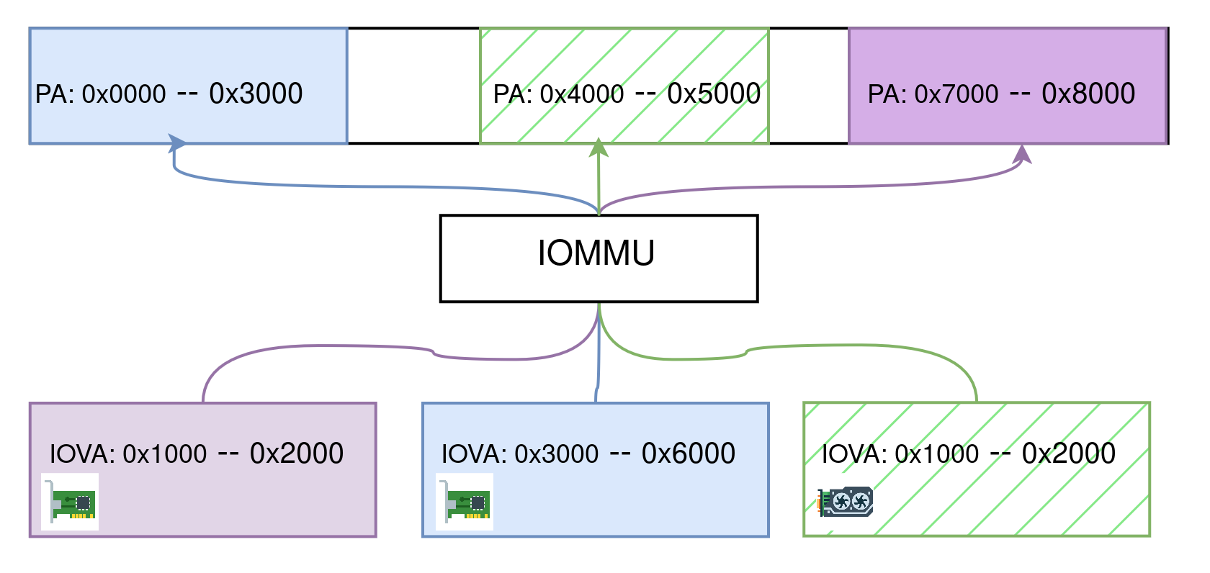
Accessing the Memory with an IOMMU
II · IOMMU
PCIe device
IOVA
IOMMU
IOVA → PA, page tables per domain, IOTLB
RAM
A domain is one IOVA address space, shared by one or more devices
Notes:
That last line is the seed of part 4. Plant it now and refer back to it when we reach pinning: no page fault means no demand paging, which means the whole guest must stay resident.

Slide 19
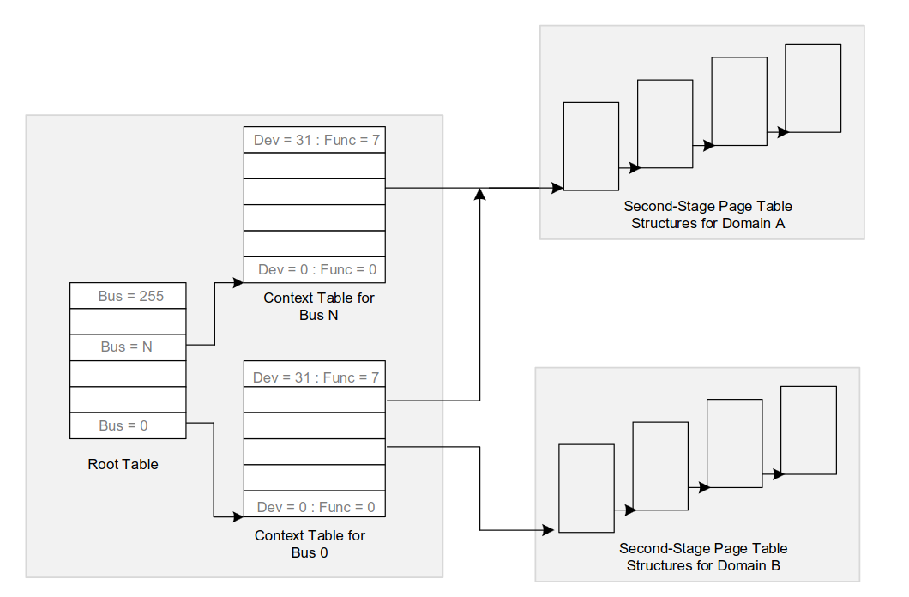
IO Address translation
II · IOMMU
Intel VT-d · Architecture Specification
Notes:
Two tables, then page tables: the identity of the requester is what selects the address space. The two stages of scalable mode are exactly what makes hardware nesting possible in part 4 — announce it here.

Slide 20
Linux hides it behind the DMA API
II · IOMMU
a = dma_map_single(dev, buf, len, dir);
/* a is an IOVA: write it
into the descriptor */
dma_unmap_single(dev, a, len, dir);
Default domain types
Type | Behaviour
identity | IOVA = PA, no protection
DMA | Translation, strict invalidation
DMA-FQ | Translation, deferred invalidation
The driver never knows whether an IOMMU is there.
Documentation/core-api/dma-api.rst · /kernel/ dma/* · /drivers/iommu/intel/*
Notes:
identity is still common on servers, purely for performance. That is quiz question 1. Also mention swiotlb: bounce buffers when the device cannot address the memory, and in confidential computing.

Slide 21
The hidden cost: IOTLB invalidation
II · IOMMU
Strict
Lazy (flush queue)
Every unmap invalidates before the buffer is released. No exposure window — but a synchronous invalidation per packet will not hold line rate.
Freed IOVAs queue up and are invalidated in batches. Fast — but the device keeps access to pages the kernel has already reused.
A real security/performance dial, exposed as iommu.strict.
Markuze et al., True IOMMU Protection from DMA Attacks, ASPLOS 2016
Notes:
Do not give orders of magnitude here — exercise 2 asks them to compute the trade-off themselves. Linux also exposes this per group through sysfs, and switches untrusted external ports to strict automatically.

Slide 22
Three questions before we virtualize
PAUSE · 5 MINUTES
Why does iommu=pt still exist, and what do we give up?
Notes:
1. Performance: no walk, no invalidation; we lose translation and isolation. 2. No — they can reach each other peer-to-peer without the IOMMU, so the VM could reach the host. 3. Because it is just a memory write: without remapping, a device, and therefore a guest, can inject arbitrary interrupts into the host.

Slide 23

Three questions before we virtualize
PAUSE · 5 MINUTES
Why does iommu=pt still exist, and what do we give up?
Notes:
1. Performance: no walk, no invalidation; we lose translation and isolation. 2. No — they can reach each other peer-to-peer without the IOMMU, so the VM could reach the host. 3. Because it is just a memory write: without remapping, a device, and therefore a guest, can inject arbitrary interrupts into the host.

Slide 24
3 ways to assign a device to a VM
III · DEVICE VIRTUALIZATION
1
2
3
Emulation
Paravirtualization
Passthrough
QEMU imitates a real device.
An interface designed for VMs: virtIO.
The real device, handed over via VFIO.
Going down the list, speed rises and the hypervisor loses control of memory.
Notes:
Announce the comparison table at the end of this part: performance, isolation, live migration, overcommit. Ask them to predict each column as we go.

Slide 25
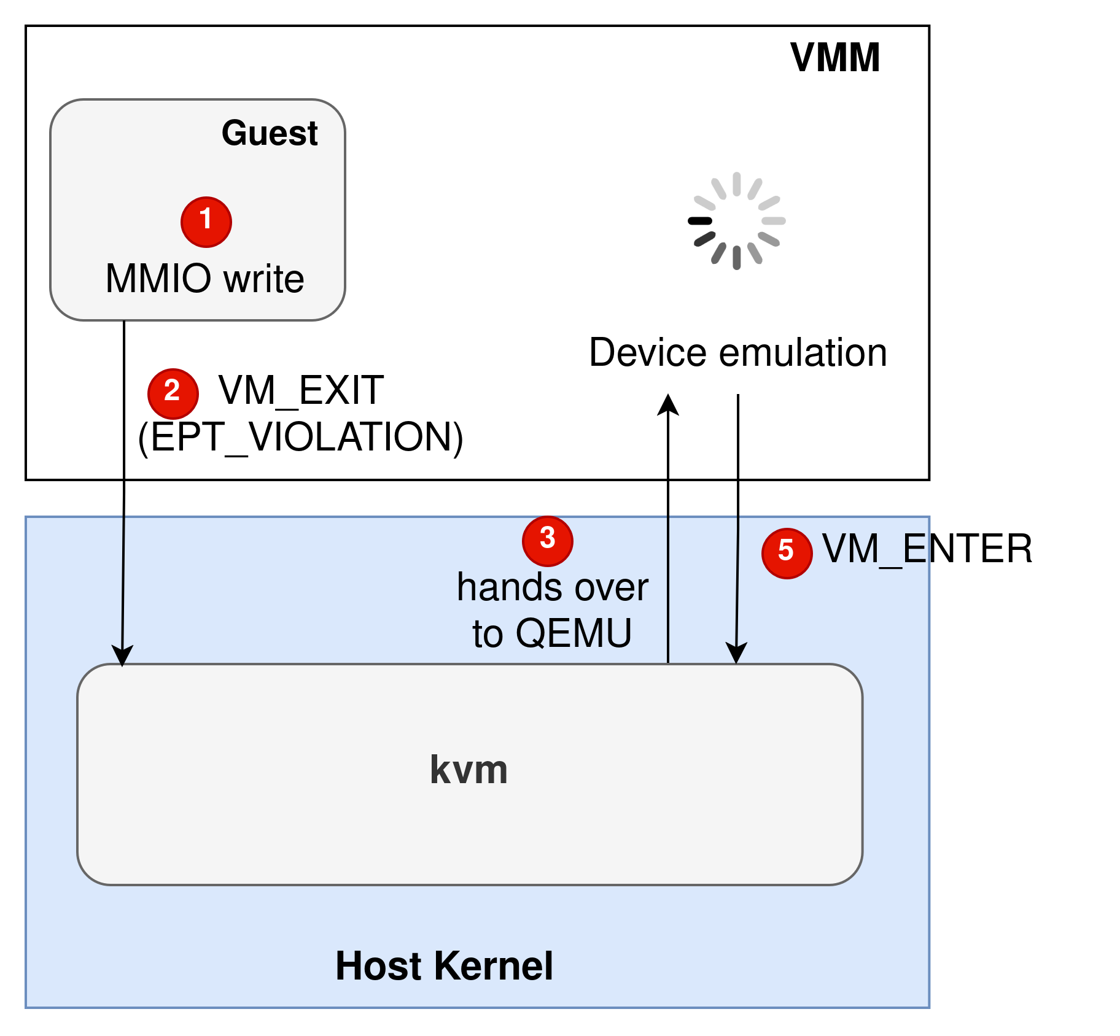
Emulation: one VM exit per access
III · DEVICE VIRTUALIZATION
Works with any guest. Costs a full round trip to userspace per register access.
Notes:
Key point for later: the device DMA here is just a memcpy inside QEMU's address space. No IOMMU needed, and guest memory stays fully managed by the host — swappable, overcommittable. That property is what we lose at stage 3.

Slide 26

Emulation: one VM exit per access
III · DEVICE VIRTUALIZATION
Works with any guest. Costs a full round trip to userspace per register access.
Notes:
Key point for later: the device DMA here is just a memcpy inside QEMU's address space. No IOMMU needed, and guest memory stays fully managed by the host — swappable, overcommittable. That property is what we lose at stage 3.

Slide 27
Paravirtualization
III · DEVICE VIRTUALIZATION
virtIO
vhost
vDPA
Virtqueues in shared memory: one notification per batch instead of an exit per register.
The data path leaves QEMU: a host kernel thread services the virtqueues, woken by an eventfd.
The NIC itself implements the virtIO data path; the control plane stays in software.
Same guest driver throughout: the interface is stable, the implementation sinks.
Virtual I/O Device (VIRTIO) Specification
Notes:
With vhost, the kernel thread attaches to QEMU's address space and uses userspace accessors, so guest pages still fault normally and stay swappable. With vDPA a real device does the DMA again — the IOMMU and pinning come back. That is the bridge to passthrough.

Slide 28
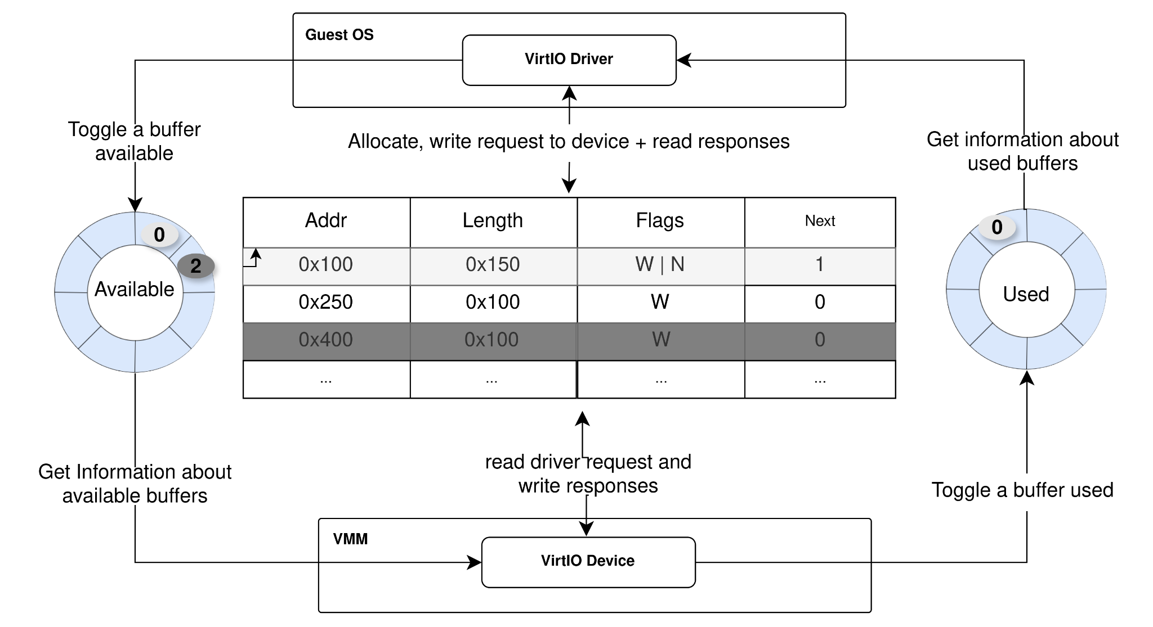
Virtio
III · DEVICE VIRTUALIZATION
Virtual I/O Device (VIRTIO) Specification
Notes:
With vhost, the kernel thread attaches to QEMU's address space and uses userspace accessors, so guest pages still fault normally and stay swappable. With vDPA a real device does the DMA again — the IOMMU and pinning come back. That is the bridge to passthrough.

Slide 29
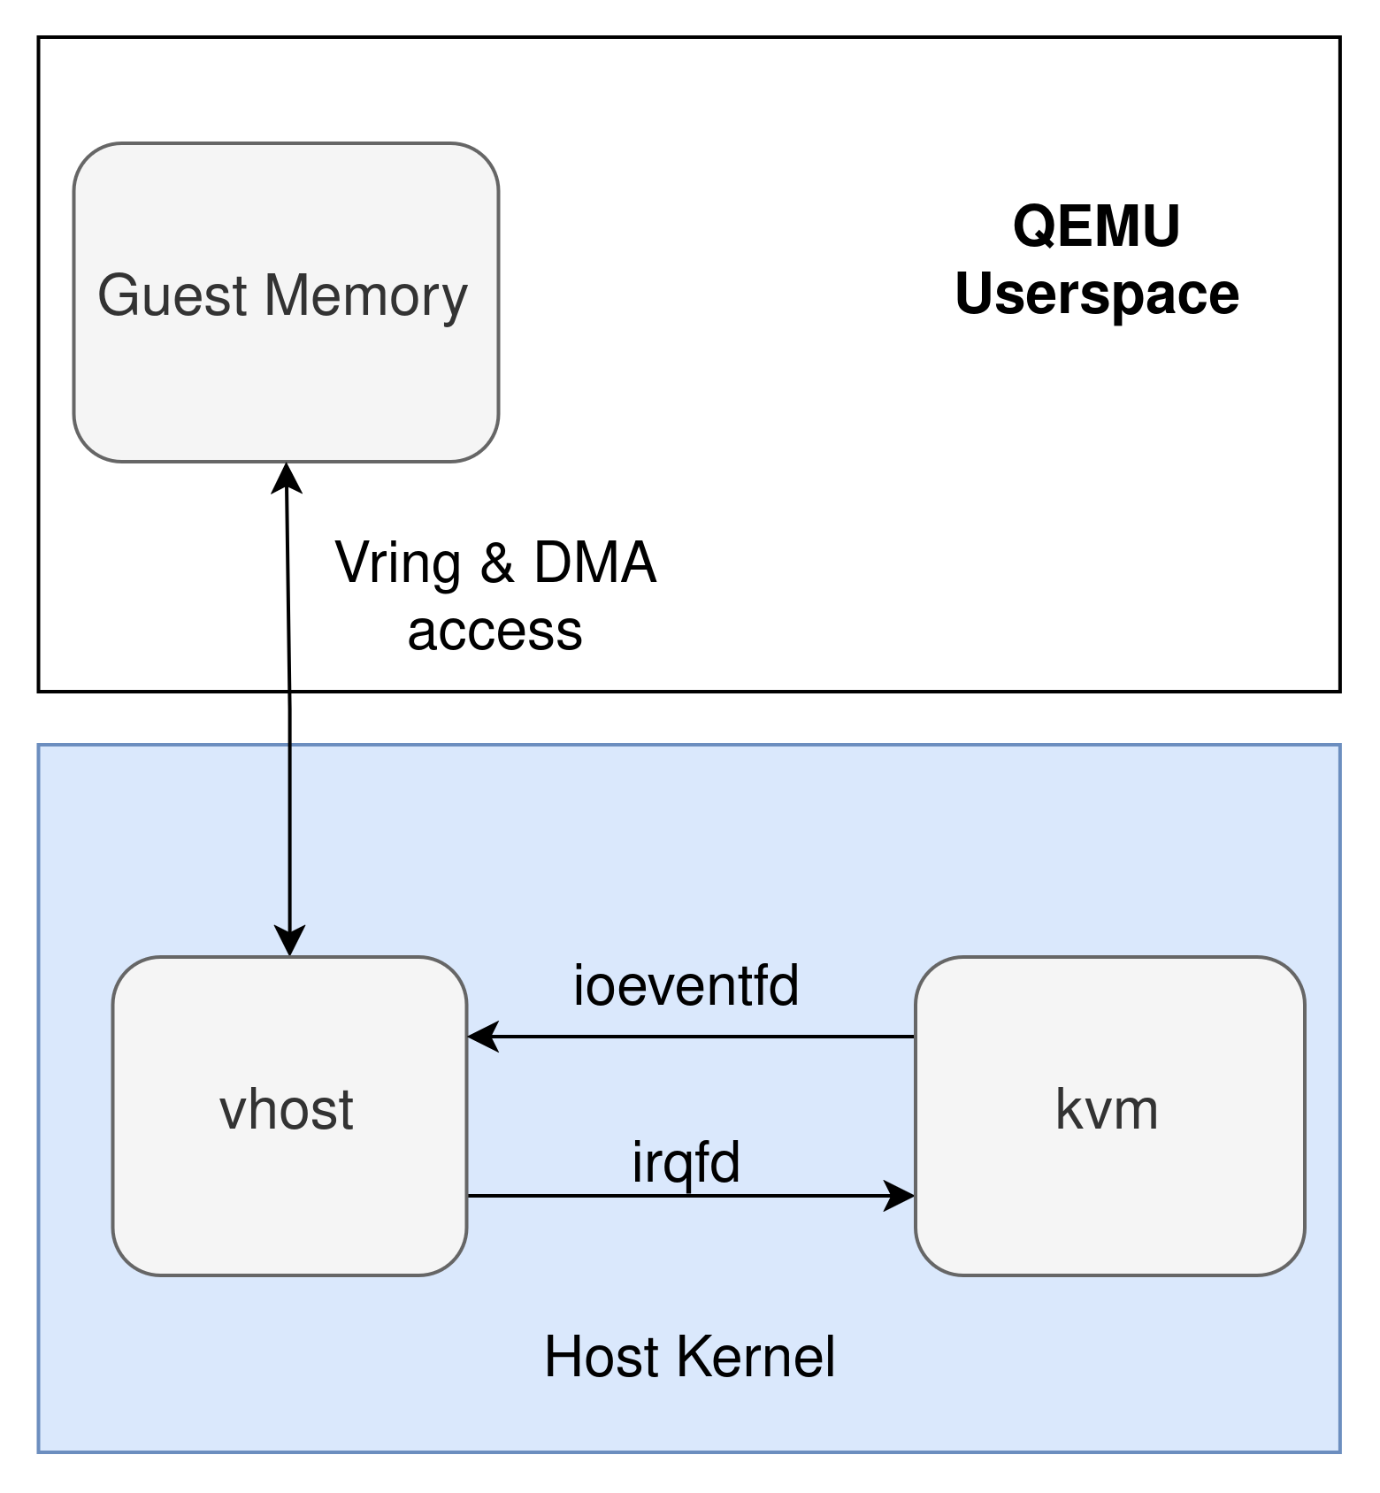
vhost
III · DEVICE VIRTUALIZATION
Two implementations based on the vhost thread location:
vhost-net in kernel
vhost-user in host userspace
Virtual I/O Device (VIRTIO) Specification
Notes:
With vhost, the kernel thread attaches to QEMU's address space and uses userspace accessors, so guest pages still fault normally and stay swappable. With vDPA a real device does the DMA again — the IOMMU and pinning come back. That is the bridge to passthrough.

Slide 30
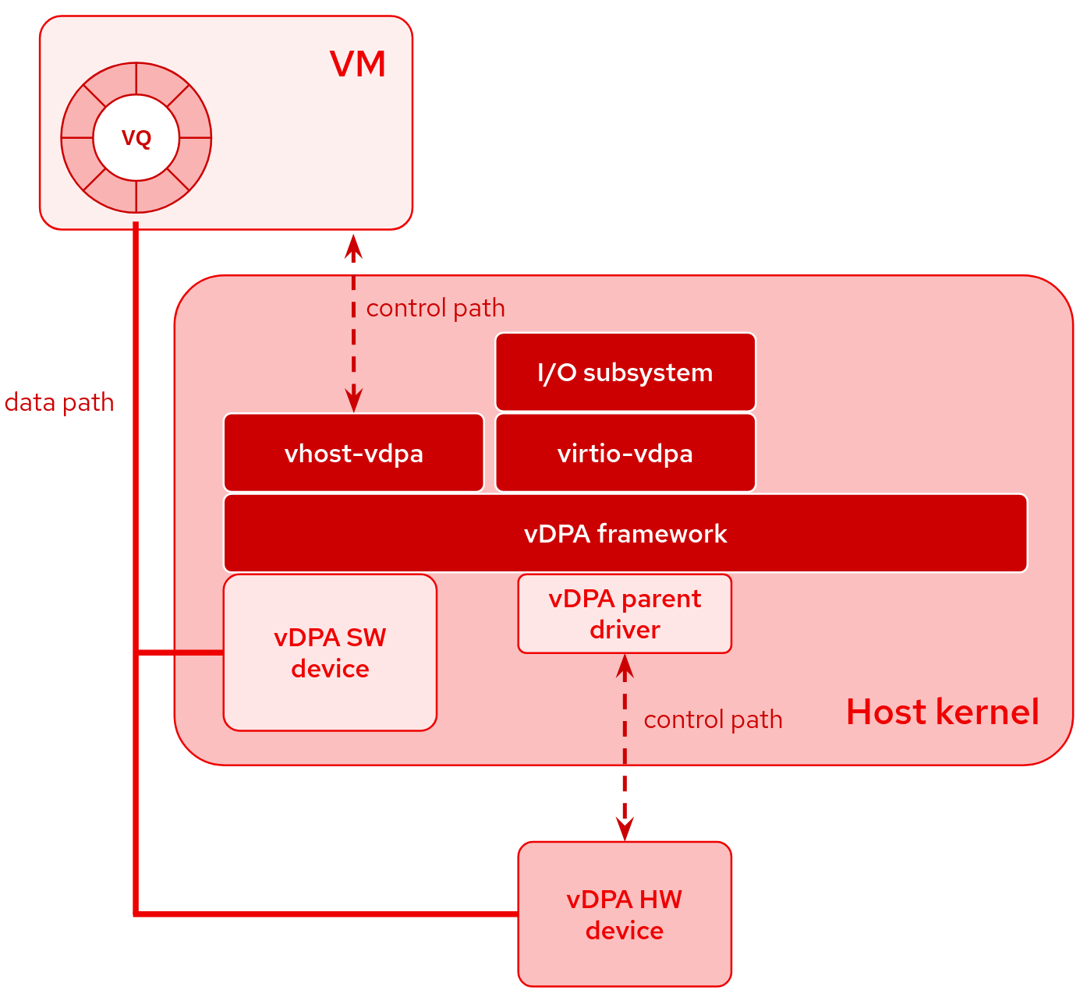
vDPA: data plane offloaded to the Hardware
III · DEVICE VIRTUALIZATION
https://vdpa-dev.gitlab.io/
Notes:
With vhost, the kernel thread attaches to QEMU's address space and uses userspace accessors, so guest pages still fault normally and stay swappable. With vDPA a real device does the DMA again — the IOMMU and pinning come back. That is the bridge to passthrough.

Slide 31
Passthrough
III · DEVICE VIRTUALIZATION
1. Guest driver writes a GPA into the descriptor
2. The NIC issues a DMA to that GPA
3. IOMMU, in the VM domain: GPA → HPA
4. The packet lands in guest RAM
VFIO
What we gain
Exposes the group to QEMU: container, group, device — or iommufd. VFIO_IOMMU_MAP_DMA installs GPA → HPA.
Zero exits on the data path: only configuration, and interrupts without posted interrupts.
Documentation/driver-api/vfio.rst
Notes:
Point out that stage 3 reuses exactly the GPA → HPA mapping the EPT already holds, but in a different table. Then ask the question and do NOT answer it: what happens if the host wants to swap a page of this VM? We return to it in part 4.

Slide 32
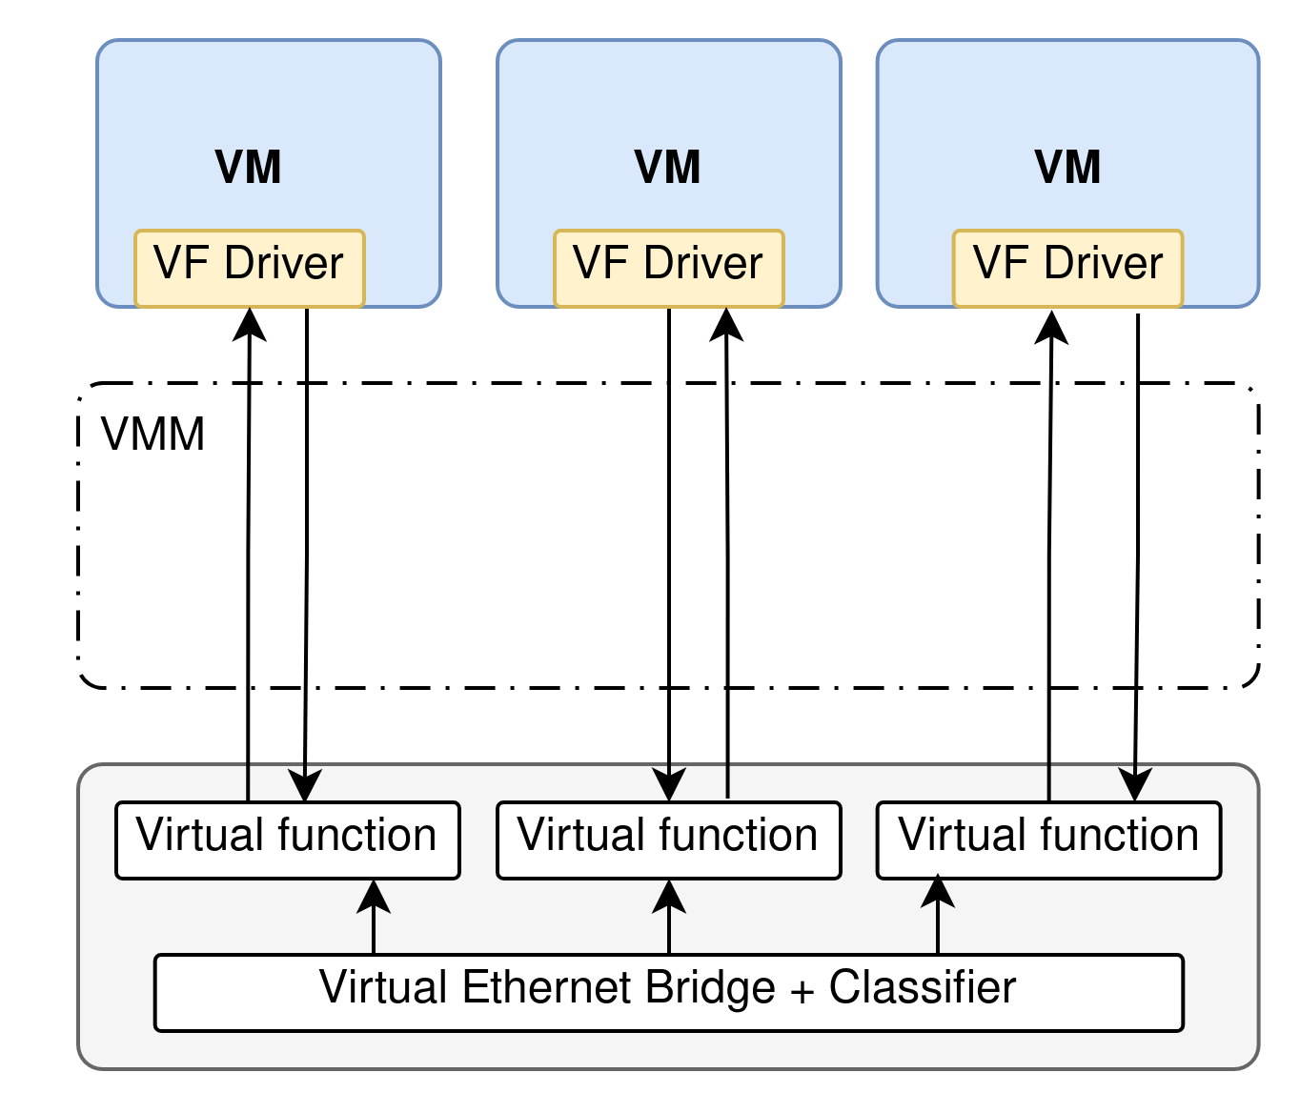
Passthrough
III · DEVICE VIRTUALIZATION
Notes:
Point out that stage 3 reuses exactly the GPA → HPA mapping the EPT already holds, but in a different table. Then ask the question and do NOT answer it: what happens if the host wants to swap a page of this VM? We return to it in part 4.

Slide 33
Sharing one physical device for Passthrough
III · DEVICE VIRTUALIZATION
SR-IOV
Posted interrupts
S-IOV and mdev
One physical function, several virtual functions. Each VF has its own Requester ID, hence its own IOMMU context.
The IOMMU delivers the interrupt straight to the target vCPU, with no VM exit at all.
Finer sharing: interfaces isolated by PASID, or a device mediated by the host driver — vGPUs work this way.
The Requester ID, then the PASID, is what lets the IOMMU keep tenants apart.
echo 4 > /sys/class/net/eth0/device/sriov_numvfs
Notes:
SR-IOV is limited by the number of VFs wired into the silicon; S-IOV moves the split to the PASID so it scales. Note that mdev and SR-IOV are still VFIO underneath, so they inherit the pinning constraint of the next part.

Slide 34
The trade-off per assignation technique.
III · DEVICE VIRTUALIZATION
Approach | Speed | Isolation | Live migration | Overcommit
Emulation | Low | Software | Yes | Yes
virtio, vhost | Good | Software | Yes | Yes
vDPA | Near native | IOMMU | Yes, via virtio state | No: pinning
Passthrough, SR-IOV | Native | IOMMU | Vendor drivers only | No: pinning
The last column is the open question of the next part.
M2 · Device virtualization
Notes:
Fill this table with the room column by column before showing it. They have seen all four stages, so they can derive most of it. Spend the time on the last column: why does a real device doing DMA force full residency?

Slide 35
Why put an IOMMU inside the guest?
IV · NESTED TRANSLATION
Protect the guest
Userspace drivers
Nesting
From its own devices, for exactly the same reasons as on the host.
DPDK or VFIO running inside the guest need an IOMMU to exist there.
Re-assigning the device to a nested VM, or to a container inside the guest.
Now two translations must compose: IOVA → GPA in the guest, then GPA → HPA in the host.
M2 · Device virtualization
Notes:
Draw the parallel with nested paging on the CPU side (EPT over guest page tables): they already know it. The difference is that here the second stage lives in the IOMMU and the guest's tables are driven by a driver the host does not trust.

Slide 36
Three ways to compose IOMMU for guest
IV · NESTED TRANSLATION
Emulated, shadowed
virtio-iommu
Hardware nesting
QEMU emulates an IOMMU so every guest map traps. QEMU composes IOVA → HPA and programs the real IOMMU.
A paravirtual interface: the guest sends MAP and UNMAP requests. Same shadowing, no hardware to imitate.
The IOMMU walks the guest tables itself, then the host ones. No exit per map — but a 2D walk on every miss.
Amit et al., vIOMMU: Efficient IOMMU Emulation, USENIX ATC 2011
Notes:
caching-mode exists precisely so the hypervisor gets a trap on map as well as unmap — normally VT-d only requires invalidation on unmap. Hardware nesting is reaching upstream QEMU through iommufd; mention that the exact option names have changed several times.

Slide 37
Two stages, one request
IV · NESTED TRANSLATION
Device
IOVA
Stage 1 — guest tables
IOVA → GPA
Stage 2 — host tables
GPA → HPA
RAM
Every pointer inside the guest tables is itself a GPA — so each level of stage 1 needs a full stage-2 walk.
Exercise 1 counts the memory accesses this costs
Notes:
This is the slide exercise 1 is built on. Make sure the recursive structure is clear before the break: the guest's table pointers are guest-physical, so resolving one of them is itself a host walk.

Slide 38
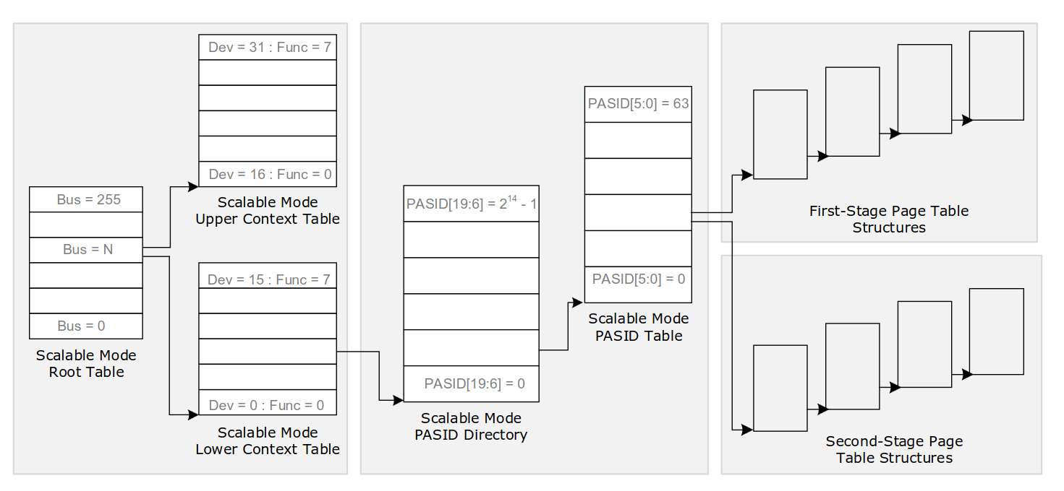
Two stages, one request
IV · NESTED TRANSLATION
Intel vt-d spec 4.1 (March 2023)
Notes:
This is the slide exercise 1 is built on. Make sure the recursive structure is clear before the break: the guest's table pointers are guest-physical, so resolving one of them is itself a host walk.

Slide 39
A device cannot wait for a page.
THE OPEN PROBLEM
So the hypervisor pins all of the guest's memory, up front.
No overcommit
No swap
No ballooning
Notes:
This answers the question left open on the passthrough slide. The device may write to any mapped page at any time; if the page is absent the DMA simply fails and the packet is lost. So QEMU maps the whole guest RAM through VFIO and the kernel pins every page. A 64 GB VM costs 64 GB of host memory, whatever it actually uses.

Slide 40
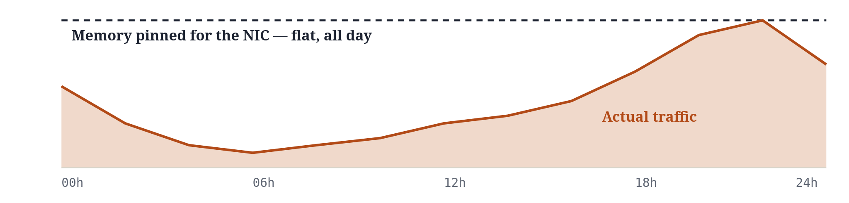
A streaming VM is busy three hours a day
04 · WHY IT MATTERS
Netflix peaks around 9pm and collapses by 4am. The VM's host memory does not: VFIO pinned every page at boot, and it stays resident until shutdown.
Shape is illustrative — replace with your own measurements if you have them
Notes:
The business framing lands well here: a provider pays for 64 GB of RAM per VM, 24 hours a day, to serve a load that only needs it for about three. With emulation or virtio those idle pages would be swapped, ballooned or shared with another tenant; with passthrough none of that is possible. Say it as a cost question rather than a technical one, then flip to the next slide for the ways out. If you want a laugh, the line that works is: we are paying rent on an empty flat, and we are not even allowed to visit it.

Slide 41
Ways out of pinning
IV · NESTED TRANSLATION
PRI and SVA
On-demand paging
Let the OS resolve device faults. Rare in hardware, and too slow for a NIC.
Some RDMA NICs handle their own faults. Vendor-specific, not a general answer.
Selective pinning
This is my thesis
Use the guest's own IOMMU to learn which pages are really mapped for DMA, and pin only those.
Memory overcommit for passthrough VMs through nested IOMMU translation.
Notes:
Two or three minutes on your own work: the idea, one number, one limitation. Fill in the bracketed placeholders before the lecture. This is also the bridge into exercise 3, which asks them to design the same mechanism from scratch.

Slide 42
Three things to keep
06 · WRAP-UP
1
DMA is what makes line rate possible, and it hands the device direct access to physical memory.
2
The IOMMU makes that access translatable and isolable; its cost lives in invalidations and walks.
3
The more directly a device is given to a VM, the faster it runs and the less the host can manage that VM's memory.
M2 · Device virtualization
Notes:
Go back to the guiding question from slide 3 and answer it in one sentence with the room. Then point out that the third line is not a settled fact but an active research area — which is where they could contribute.

Slide 43
Questions
GOING FURTHER
Intel, Virtualization Technology for Directed I/O, Architecture Specification
Tang et al DMA cache: Using on-chip storage to architecturally separate I/O data from CPU data for improving I/O performance, HPCA-16 2010
Ben-Yehuda et al., Utilizing IOMMUs for Virtualization in Linux and Xen, OLS 2006
Amit et al., vIOMMU: Efficient IOMMU Emulation, USENIX ATC 2011
Markuze et al., True IOMMU Protection from DMA Attacks, ASPLOS 2016
Linux: Documentation/driver-api/vfio.rst, Documentation/userspace-api/iommufd.rst
Luc MAHOP · mahopmaj@univ-grenoble-alpes.fr
Notes:
If there is time left, open on the research side: which of the three ways out of pinning would they bet on, and why. It is a good way to end on a discussion rather than on a summary.

Slide 44
What it looks like on a real machine
05 · LIVE DEMO
$ dmesg | grep -i -e DMAR -e IOMMU
$ ls /sys/kernel/iommu_groups/*/devices
$ cat /sys/kernel/iommu_groups/*/type
$ lspci -k -s [BDF]
$ qemu-system-x86_64 ... -device intel-iommu,caching-mode=on
$ perf kvm stat live
Test this beforehand: QEMU tracing needs a build with a trace backend
Notes:
Suggested order: is the IOMMU on, what are the groups, which domain type, which driver owns the NIC. Then boot a VM with an emulated vIOMMU and show the map and invalidation traces scrolling during a ping, and count exits with perf kvm stat. If the room has no machines, a recorded terminal works just as well.

Slide 45
What a 2D walk costs
05 · EXERCISE · 8 MINUTES
How many memory accesses to translate one IOVA?
Same question with 2 MB pages on the host side.
Why does an IOTLB miss hurt a NIC more than a TLB miss hurts a CPU?
Setup
Guest: 4 levels, IOVA → GPA
Host: 4 levels, GPA → HPA
Empty IOTLB, no walk cache
Hint for 1: every guest table pointer is a GPA
Notes:
1. Each of the 4 guest levels costs a 4-access host walk to locate the entry, plus reading it: 5 each. The final GPA costs 4 more. Total (4+1)(4+1) − 1 = 24. 2. Host walk drops to 3 levels: (4+1)(3+1) − 1 = 19. 3. A CPU hides latency with out-of-order execution and other threads; a NIC has small internal buffers, so a long miss becomes a dropped packet. Ring buffers are also scattered, so IOTLB locality is poor.

